Slide 1
Fake news detection using Natural language processing approaches
By Dr. Gargi Mishra
(SpringBoard DS track student)
WHY FAKE NEWS IS A PROBLEM?
Fake news → misinformation, disinformation or mal-information
spread through word of mouth, traditional media , digital forms of communication such as edited videos, memes, unverified advertisements and social media propagated rumours.
Fake news → potential of it resulting in mob violence, suicides etc
https://www.kaggle.com/clmentbisaillon/fake-and-real-news-dataset

Slide 2
Problem Statement Worksheet (Hypothesis Formation)
Create and train a machine learning model so that it can correctly predict whether a given piece of news is Real or Fake
1
Context
4
Constraints within solution space
40000 articles consisting of fake as well as real news
The fake and real news data is given in two separate datasets with each dataset consisting around 20000 articles each
Data is very big, space constraints
Error in text, ambiguity, sarcasm, homonyms not understood
Slangs, domain specific language are not preprocessed perfectly
2
Criteria for success
5
Stakeholders to provide key insight
This project proposes the question of whether it is possible to detect fake news through machine learning models. Specifically, the aim of this project is to determine the ideal model that is efficient in predicting fake news while also limiting the cost of memory and storage for computation
Clement Bisaillon
3
Scope of solution space
6
Key data sources
Feature extraction
Right preprocessing of the text
Choosing the right models and comparing the accuracy
Kaggle
Notes:
Hypothesis: Create a Hypothesis with an emphasis on SMART principles. (S – Specific, M – Measurable, A – Achievable, R – Realistic, T – Timebound). If you cannot do this, you do not have a good grasp on the business problem.
Context: With context, we have clearly identified the problem at hand and have elucidated on how our initiative may solve this problem, alongside the commercial implications this will have on the business.
Criteria for Success: Clearly defining the criteria for success ensures that the scope of your work is clearly defined and understood. Otherwise, if this isn’t defined – your work will never end which will result in mismatched expectations.
Scope of Solution Space: Scoping out the solution space ensures that the business initiative is SPECIFIC for a certain segment or area. This prevents solutions that have been developed being scaled and applied for all other business units that the solution may not be responsible or scalable for.
Constraints within Solution Space: Looking forward, what are the foreseeable problems we are likely to encounter? Could this be stakeholder resistance? Could this be we don’t have access to the right data?
Stakeholders to provide key insight: Who are the people I need to speak to, to get the answers I need for my data analysis?
What key data sources are required?
Based off my discussions with the key stakeholders – can we clearly list out all the data sources we need so we can make a highly targeted request as opposed to a scatter-gun approach where we ask for a bit of everything?

Slide 3
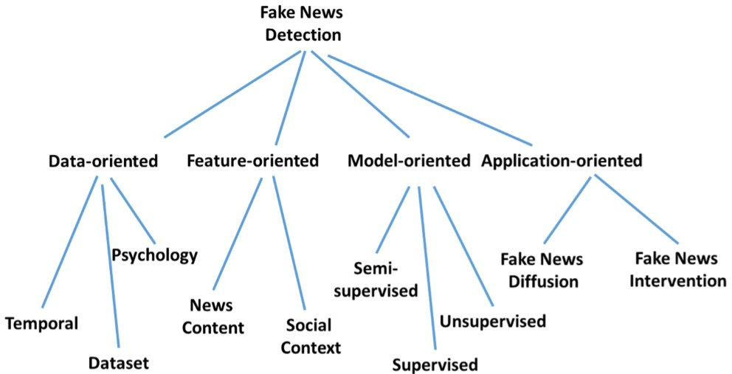
Do you trust all the news you hear from social media? All news is not real, right? So how will you detect the fake news?
Strategies to identify fake news

Slide 4
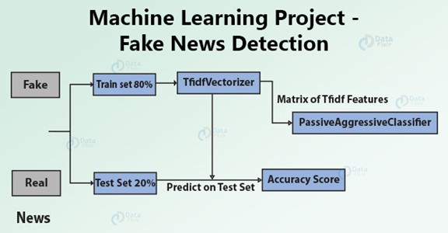
Steps of data analyses
Data Collection: provided by Kaggle
Data Analysis and Interpretation: Analyzing from a feature-based perspective
Data Preprocessing Methodology: After proper analysis and interpretation, we need to prepare and sanitize the data for it to be suitable for more in- sights into the learning process
Learning Model Selection (Which model suits well the given problem
Update the Model for better Accuracy: Here we try to tune the parameters/hyperparameter to obtain a better accuracy from the selected model

Slide 5
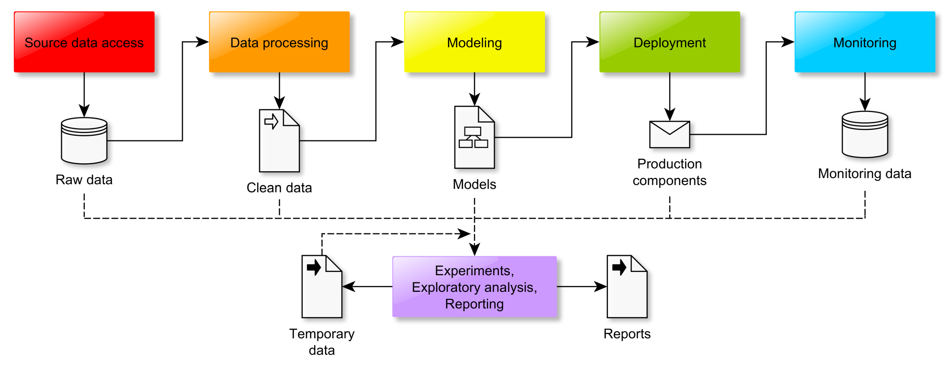
Design Workflow

Slide 6
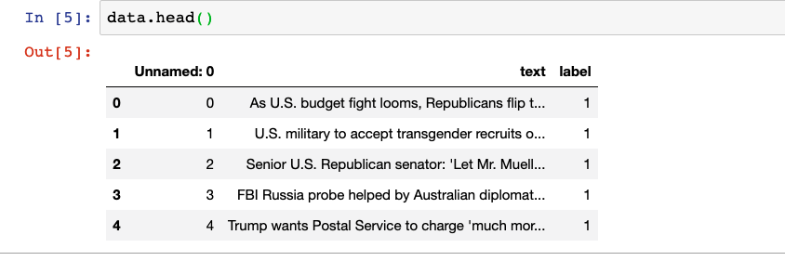
Data wrangling
Fake.csv : which have a sample data of shape 23481 by 4 with 04 features (’title’, ’text’, ’subject’, ’date’) and contains only fake news
True.csv : which have a sample data of shape 21417 by 4 with 04 features (’title’, ’text’, ’subject’, ’date’) and contains only real news
The above two dfs were concatenated to give data.csv which contains:
’title’: The first column contains the title of the news.
’text’ : The second column contains the plain-text news.
‘subject’: category of news
‘date’: date of news
’label’ : The third column has labels denoting whether the news is REAL or FAKE
Merging the dataframes and reassigning columns
data['text'] = data['title'] + " " + data['text']
data = data.drop(['title', 'subject', 'date'], axis=1)

Slide 7
Exploring the subjects
Two main subjects in fake new: politics and world news

Slide 8
Wordcloud: True & fake
Fake
True
World cloud gives an idea of the frequency of the different words used in the dataset: Fake news has a higher frequency of ‘Trump’ as compared to True news (not surprised!!) Gives an idea of where to looks for in the headlines and get skeptical!

Slide 9
Preprocessing
Some of the preprocessing steps used are:
Removing punctuations like . , ! $( ) * % @
Removing URLs
Removing Stop words
Lower casing
Tokenization
Stemming
Lemmatization
https://github.com/gargiimishra/DataScience_SpringBoard/blob/5a37c2b2d420104b141a024e73db78ffd947555e/preprocessing_model_true_fake.ipynb

Slide 10
Modelling
Multinomial Naïve Bayes Algorithm
The algorithm is based on the Bayes theorem and predicts the tag of a text. It calculates the probability of each tag for a given sample and then gives the tag with the highest probability as output.
Posterior Probability = (Prior * Likelihood)/(Evidence)
Two assumptions for applying MNB:
Features are independent of each other
Each feature follows multinomial distribution
Posterior probability evolves with arriving data points and performs better in next iterations
Accuracy: 93.953
Notes:
Naive Bayes classifier is a collection of many algorithms where all the algorithms share one common principle, and that is each feature being classified is not related to any other feature. The presence or absence of a feature does not affect the presence or absence of the other feature.
P(A|B) = P(A) * P(B|A)/P(B)
Posterior Probability = (Prior * Likelihood)/(Evidence)

Slide 11
Support vector Machine: SVM
Used linearSVC for Classification
Used SVC with rbf Kernel
LinearSVC
accuracy: 99.443
The algorithm tries to find an optimal hyperplane which can be used to classify a new data point. It finds the most similar examples between classes
SVC with rbf kernel
accuracy: 96.728
https://towardsdatascience.com/svm-and-kernel-svm-fed02bef1200
Notes:
The algorithm tries to find an optimal hyperplane which can be used to classify a new data point. It finds the most similar examples between classes. Those will be the support vectors for linear dat sets we use Linear SVC
For non linear datasets we use Kernel trick
The basic steps of the SVM are:
select two hyperplanes (in 2D) which separates the data with no points between them (red lines)
maximize their distance (the margin)
the average line (here the line half way between the two red lines) will be the decision boundary

Slide 12
Passive Aggressive Classifier
How Passive-Aggressive Algorithms Work:
Passive-Aggressive algorithms are called so because :
• Passive: If the prediction is correct, keep the model and do not make any changes. i.e., the data in the example is not enough to cause any changes in the model.
• Aggressive: If the prediction is incorrect, make changes to the model. i.e., some change to the model may correct it.
Aonline-learning algorithm will get a training example, update the classifier, and then throw away the example
Input data comes in sequential order and the machine learning model is updated step-by-step, as opposed to batch learning, where the entire training dataset is used at once

Slide 13
Passive Aggressive Classifier
accuracy: 99.443
Better performing model than Multinomial NB and SVM

Slide 14
Conclusion and prospects
Passive-Aggressive classifier performs the best classification of true fake news
Feature Engineering can be improved to the model efficacy further
Deep Learning models can be applied. Since I got a decent accuracy of 99.563 so I did not do it.
Limited public labelled dataset availability (here we have worked on a small dataset, might be overfitting)
Sentiment analyses can also be added to model.
A bigram or multigram model can be made

